Slide 1
Testing Levels & Types
Prepared by: Mridula
Dated: 16-Jan-2020

Slide 2


Slide 3
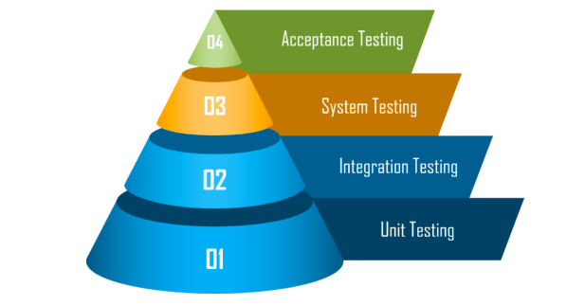
Introduction
Before an application is released , it undergoes a thorough testing process to ensure that it is working in the manner in which it was intended.
There are four main stages of testing that need to be completed before a program can be cleared for use:

Slide 4

Unit Testing / Component Testing
Unit testing aims to verify each part of the software by isolating it and then perform tests to demonstrate that each individual component is correct in terms of fulfilling requirements and the desired functionality.
This type of testing is performed at the earliest stages of the development process.
In many cases it is executed by the Developers themselves before handing the software over to the testing team.

Slide 5


Slide 6
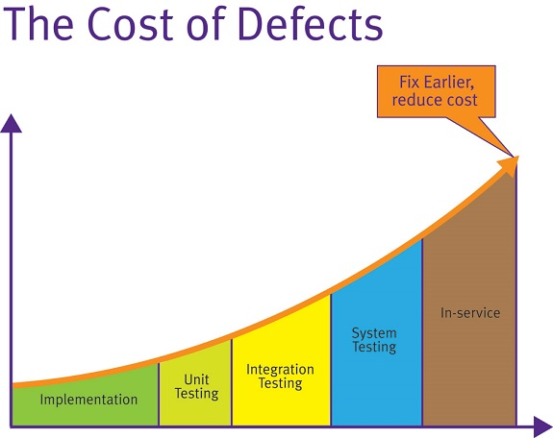
Why Unit Testing ?
It finds problems early in the development cycle.
So it reduces the cost of testing.
It simplifies the debugging process.
Unit testing improves the quality of the code.
It identifies every defect that may have come up
before code is sent further for integration testing.
It exposes the edge cases and makes you
write better code.

Slide 7
Tools used for Unit Testing
TestNG
It is a testing framework for the Java programming
Nunit
Unit-testing framework for all .NET languages.
Junit
PHPUnit
unit testing framework for the PHP programming language.

Slide 8
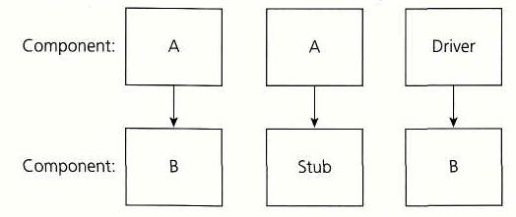
Component Testing
Component testing, also known as program or module testing, is done after unit testing.
Component testing is a method where testing of each component in an application is done separately.
Component testing is also known as module and program testing. It finds the defects in the module and verifies the functioning of software.
Component testing is done by the tester.
The main objective of component testing is to verify the input/output behaviour of the test object.

Slide 9
Integration Testing
It is a level of software testing where individual units are combined and tested as a group.
The purpose of this level of testing is to expose faults in the interaction between integrated units.
Integration testing takes as its input modules that have been unit tested, groups them in larger aggregates, applies tests defined in an integration test plan to those aggregates, and delivers as its output the integrated system ready for system testing.
Testers are mainly responsible for Integration Testing.
Example : A car engine is made up of different parts such as a piston , Crankshaft , connecting rod , clutch plate . They all are made separately . Integration testing comes into play when all of these parts are combined together to make a working engine.

Slide 10
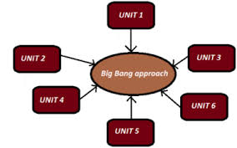
Integration Testing Approaches
Big Bang Approach –
Big Bang is an approach to Integration Testing where all or most of the units are combined together and tested at one go. This approach is taken when the testing team receives the entire software in a bundle. So it tests only the interactions between the units.

Slide 11

Drivers & Stubs

Slide 12
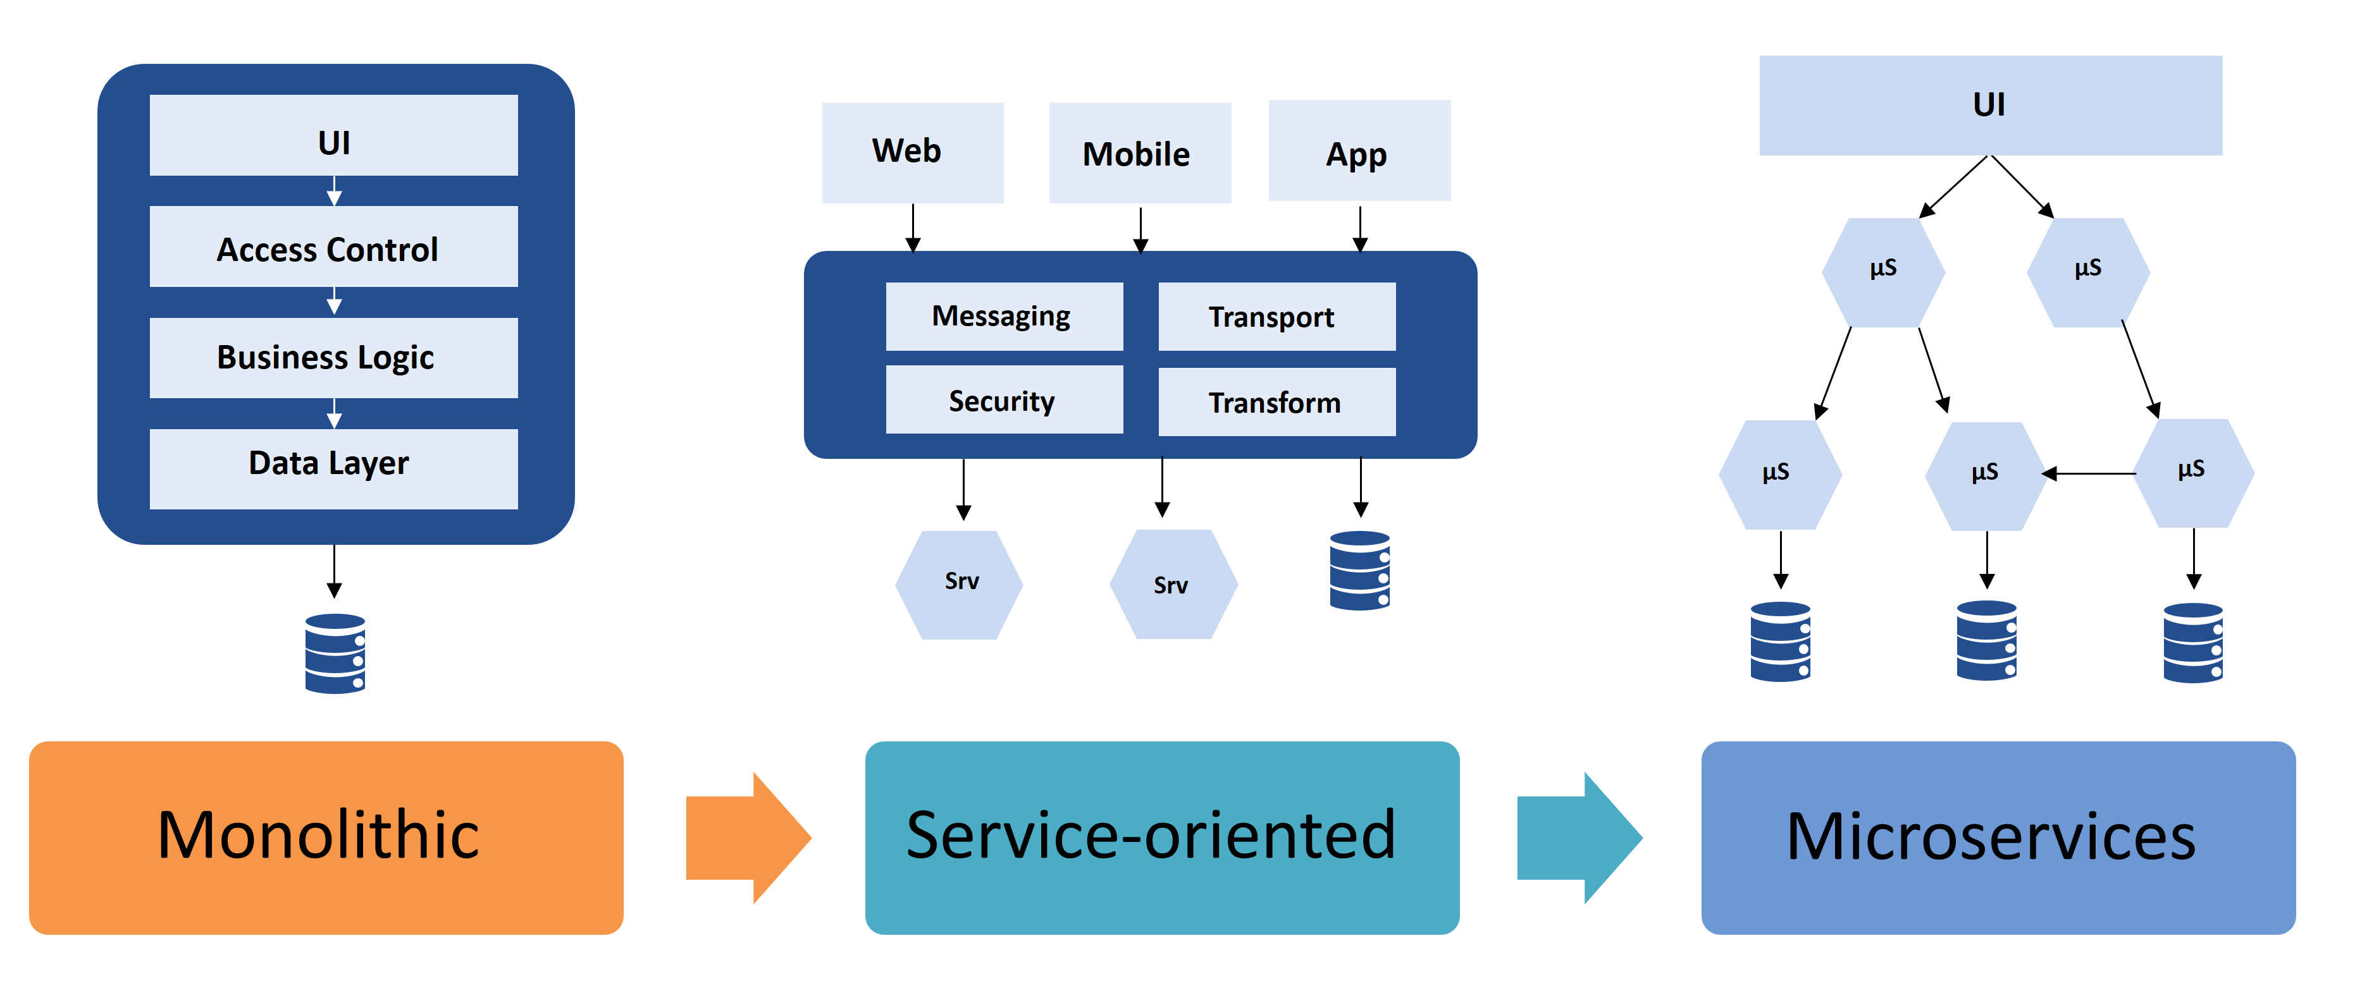
Software Architecture

Slide 13
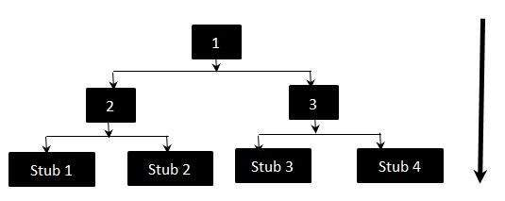
Top Down Approach – Integration Testing where top-level units are tested first and lower level units are tested step by step after that. This is carried out using dummy modules known as Stubs if a module is not ready for integration testing.
Testing Approach: The integration between the modules 1,2 and 3 Test the integration between the module 2 and stub 1,stub 2 Test the integration between the module 3 and stub 3,stub 4

Slide 14
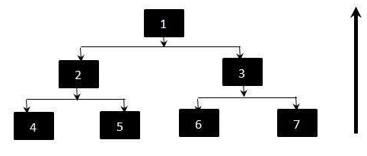
Bottom Up Approach
Bottom Up is an approach to Integration Testing where bottom level units are tested first and upper-level units step by step after that. Drivers are used as dummy modules.
Testing Approach: Test 4,5,6,7 individually using drivers.
Test 2 such that it calls 4 and 5 separately. If an error occurs we know that the problem is in one of the modules.
Test 1 such that it calls 3 and If an error occurs we know that the problem is in 3 or in the interface between 1 and 3

Slide 15
Drivers

Slide 16

Drivers
Used in top bottom up approach
Emulates a calling function
Drivers invoke modules under testing
Created for testing of modules at lower level
Examples:
Simple Code snippets that invokes component
SoapUI, Fiddler for APIs testing

Slide 17

Stubs

Slide 18
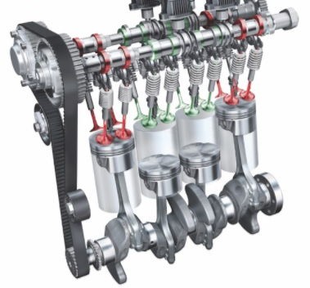
Stubs
Used in top down approach
Emulates the called function
Stubs stimulates the activity of missing and not developed modules
Created when high level modules are tested but lower level modules are not developed/available
Examples:
Service Mocking
Dummy functions

Slide 19

Why Integration Testing ?

Slide 20

Why Integration Testing ?
The application is tested in order to verify that it meets the standards set by the client
Preventing defects from escaping to higher test levels.
Building confidence in the quality of the system.
Code Coverage is higher and easy to track.

Slide 21
System Testing
System testing is the first level in which the complete application is tested as a whole.
The goal at this level is to evaluate whether the system has complied with all of the outlined requirements and to see that it meets Quality Standards.
System testing is undertaken by independent testers who haven’t played a role in developing the program.
This testing is performed in an environment that closely mirrors production.

Slide 22
System Testing Process
Setup Test Environment
Generate Test cases
Generate Test Data
Execute Test cases
Retesting
Defect Fixing
Defect Logging

Slide 23
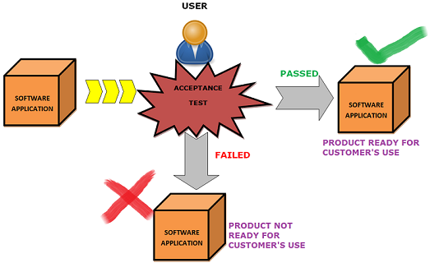
Acceptance Testing
The final level, Acceptance testing (or User Acceptance Testing), is conducted to determine whether the system is ready for release.
During this final phase, the user will test the system to find out whether the application meets their business’ needsso as to declare it acceptable or non-acceptable for its use by the users

Slide 24
Types of Acceptance Testing
Internal Acceptance Testing (Also known as Alpha Testing) :
It is an on-site acceptance testing executed at developer's site usually by the group of skilled testers. This is carried out at the end of the software development process and before the handing over of the software product to clients/users.
The feedback or the collected result from the alpha testing is significantly used to fix bugs or defects.
Beta Testing :
Also known by the name field testing, Beta Tesing is an off-site acceptance testing, carried out at client's site by the stakeholder or the end-users. This testing involves the evaluation of the software in the real environment by its potential users before its actual release in the market.
User Acceptance Testing (UAT) : User acceptance testing (UAT) is the last phase of the software testing process performed by users/ clients. During UAT, actual software users test the software to make sure it can handle required tasks in real-world scenarios, according to specifications. This is typically the last step before the product goes live or before the delivery of the product is accepted. This is performed after the product itself is thoroughly tested.

Slide 25
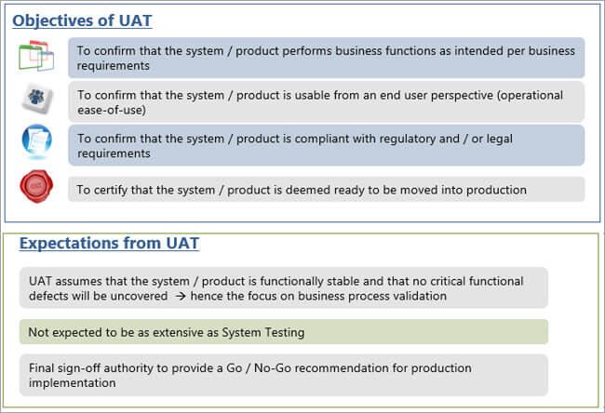

Slide 26
UAT In Agile Environment
The agile environment is more dynamic in nature. At the beginning of the project, business users would be the key stakeholders to provide requirement thereby updating the product backlog.
During the end of each sprint, business users would participate in the sprint demo and would be available for providing any feedback.
Moreover, a UAT phase would be planned before the sprint completion where the business users would do their validations.
The feedbacks which are received during sprint demo and sprint UAT, are collated and added back to the product backlog which is constantly reviewed and prioritized.

Slide 27
Why Acceptance Testing ?
To find the defects missed during the functional testing phase.
How well the product is developed.
Helps verify that the software is developed according to the business requirements of the client.
Most importantly, it ensures the product is ready to be used by the real users, as it verifies the criteria for product delivery to the users.

Slide 28
Testing Types
Testing Types
Functional Testing
Non Functional Testing

Slide 29
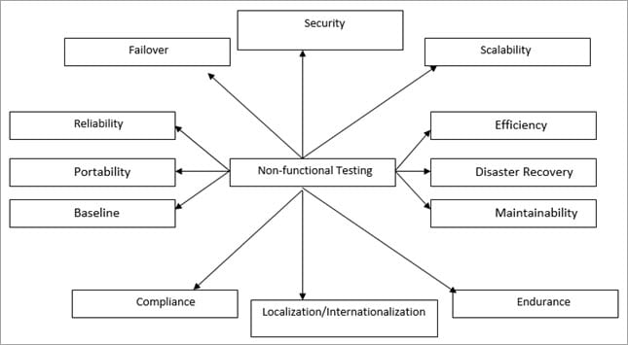
Non Functional Testing

Slide 30
Load Testing:
Evaluates whether the system’s performance is as expected under normal and expected conditions.
Stress Testing:
Evaluates whether the system’s performance is as expected when it is low on resources.
Volume Testing:
Evaluates the behaviour of the software when a large volume of data is involved.
Usability Testing:
Evaluates the system for human use or checks if it is fit for use.
Recovery Testing:
Evaluates that the application terminates gracefully in case of any failure and the data is recovered appropriately from any hardware and software failures.
Security Testing:
Security Testing is done to ensure that the application has no loopholes which could lead to any data loss or threats.
Compliance Testing:
Compliance testing is done to verify if the standards defined are being followed or not. Audits are done to verify the same

Slide 31
Functional Testing
The testing types are as follows:
Sanity Testing
Sanity Testing is a subset of regression testing. Sanity testing is a kind of Software Testing performed after receiving a software build, with minor changes in code, or functionality, to ascertain that the bugs have been fixed and no further issues are introduced due to these changes.
Smoke Testing
Smoke Testing is a kind of Software Testing performed after software build to ascertain that the critical functionalities of the program are working fine. It is executed "before" any detailed functional or regression tests are executed on the software build.
Regression Testing
Regression Testing is nothing but a full or partial selection of already executed test cases which are re-executed to ensure existing functionalities work fine

Slide 32
THANK YOU
Q & A

